Slide 1
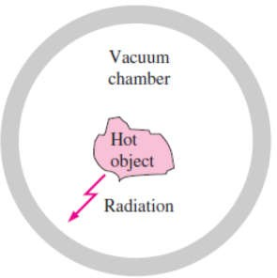
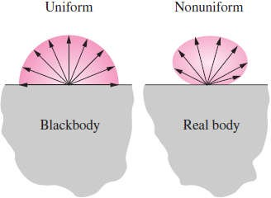
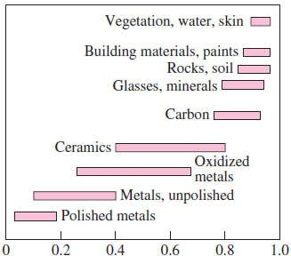
Chapter Eight
Radiation Heat Transfer
8.1- Introduction
Consider a hot object that is suspended in an evacuated chamber whose walls are at room temperature Fig.(8.1). Heat transfer between the object and the chamber could not have taken place by conduction or convection, because these two mechanisms cannot occur in a vacuum. Therefore, heat transfer must have occurred through another mechanism that involves the emission of the internal energy of the object. This mechanism is radiation. Radiation differs from the other two heat transfer mechanisms in the following points;
It does not require the presence of a material medium to take place.
In fact, energy transfer by radiation is fastest (at the speed of light) and it suffers no attenuation in a vacuum.
Also, radiation transfer occurs in solids as well as liquids and gases. In most practical applications, all three modes of heat transfer occur
concurrently at varying degrees. But heat transfer through an evacuated space can occur only by radiation. For example, the
energy of the sun reaches the earth by radiation.
Heat transfer by conduction or convection takes place in the direction of decreasing temperature; that is, from a high-temperature medium to a lower-temperature one. It is interesting that radiation
heat transfer can occur between two bodies separated by a medium Fig.(8.1) A hot object in a vacuum colder than both bodies. For example, solar radiation reaches thechamber loses heat by radiation only surface of the earth after passing through cold air layers at high
altitudes.
8.2- Blackbody Radiation
The A blackbody is defined as a perfect emitter and absorber of radiation. A blackbody absorbs all incident radiation, regardless of wavelength and direction. Also, a
blackbody emits radiation energy uniformly in all directions per unit area normal to direction of emission. Fig.(8.2). That is, a blackbody is a diffuse emitter. The term
The radiation
energy emitted by a blackbody per unit time and per unit surface area can be determined by Stefan Boltzmann law as follow;
4
Fig.(8.2) A blackbody is said to be a diffuse emitter since it emits radiation energy uniformly in all directions
Eb (W / m²)
where = 5.67 ×10⁻⁸ (W/m² · K⁴) is the Stefan Boltzmann
constant and T is the absolute temperature of the surface in
(K°) and Eb is called the blackbody emissive power.
8.3- Radiative Properties
8.3.1- Emissivity
The emissivity of a surface represents the ratio of the radiation emitted by the surface at a given temperature to
the radiation emitted by a blackbody at the same temperature. The emissivity of a surface is denoted by , and it takes the range of; 0 1, as shown in Fig.(8.3) So, the emissivity is a measure of how closely a surface
approximates a blackbody, for which , for a whit body surface = 0 and for gray bodies it lies between 0 to 1.
Fig.(8.3) Typical ranges of emissivity for various materials

Slide 2
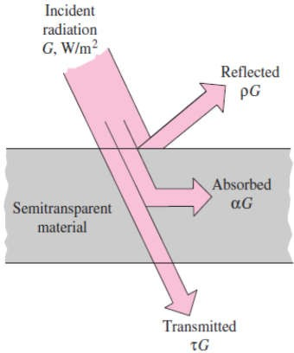
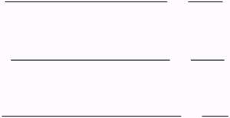
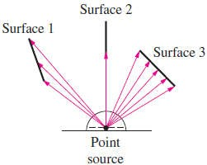
Chapter Eight
Radiation Heat Transfer
8.3.2- Absorptivity, Reflectivity, and Transmissivity
When radiation strikes a surface, part of it is absorbed, part of it is reflected, and the remaining part, if any, is transmitted, as illustrated in Fig.(8.4).
The fraction of irradiation absorbed by the surface is called the
absorptivity , the fraction reflected by the surface is called the
reflectivity transmissivity
Absorptivity;
, and the fraction transmitted is called the
, that is;
Absorbed Radiation G_{abs} Incident Radiation G
Reflected Radiation G_{ref} Incident Radiation G Transmitted Radiation G_{tr} Incident Radiation G
0 1
0 1 (8.2)
0 1
Reflectivi ty;
Transmitivity;
where G is the radiation energy incident on the surface, and Gabs, Gref, and Gtr are the absorbed, reflected, and transmitted portions of
it, respectively. Thus, according to the first law of thermodynamics we have;
Fig.(8.4) The absorption, reflection,
^{G}abs ^{G}ref ^{G}tr
G (8.3.a)
and transmission of incident radiation
or;
1
(8.3.b)
Note1- For blackbody surfaces (which neither reflects nor transmits any part of the incident radiation but absorbs all of it), = 0 & = 0, thus;
1
(8.3.c)
Note2- If all the incident radiation falling on a body is reflected, it is called "a white body" for which, and = 0, thus;
1
(8.3.d )
Note3- For opaque surfaces (solids or liquids), = 0, and thus;
1
(8.3.e)
8.4- The View Factor
Radiation heat transfer between surfaces depends on the orientation of the surfaces relative to each other, as illustrated in Fig.(8.5), so, we define a new parameter called the view factor, which is a purely geometric quantity and is independent of the surface properties and temperature. It is also called the shape factor, configuration factor, and angle factor. The view factor from a surface i to a surface j is denoted by F or just Fij, and is defined as; Fij = The fraction of the radiation leaving surface i that strikes
Surface j directly
Therefore, the view factor F12 represents the fraction of radiation leaving surface1 that strikes surface2 directly, and F21 represents the
fraction of radiation leaving surface2 that strikes surface1 directly. So, if the two surfaces 1 and 2 of surface areas A1 and A2 respectively, then the shape factors of each one of them will be computed as follow;
A1 F12 = A2 F21
which is known as the reciprocity relation for view factors.
Fig.(8.5) Radiation heat exchange between surfaces depends on the orientation of the surfaces relative to each other

Slide 3
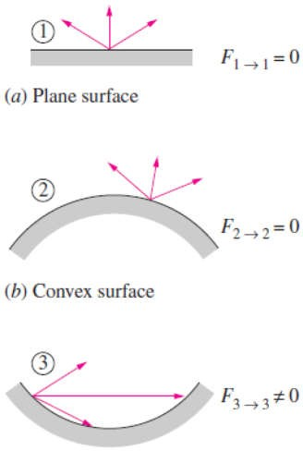
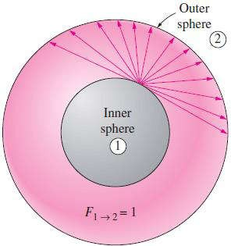
Chapter Eight
Radiation Heat Transfer
Note1- For the special case of j = i, we have;
F = the fraction of radiation leaving surface i that strikes itself directly
So, if the radiation beams travel in straight paths, the view factor from a surface to itself will be zero unless
itself. Therefore, and as illustrated in Fig.(8.6) we have; 1- F = 0 for plane surfaces.
2- F = 0 for convex surfaces. 3- F for concave surfaces.
Note2- The value of the view factor lies between 0 Fij . The limiting case Fij = 0 indicates that the two surfaces do not have a direct view of each other, and thus radiation leaving surface i cannot strike surface j directly. The other limiting case Fij = 1 indicates that surface j completely surrounds surface i, so that the entire radiation leaving surface i is intercepted by surface j, as shown in Fig.(8.7), where the entire radiation leaving the surface
of the smaller sphere (surface1) will strike the larger sphereFig.(8.6) The view factor from a surface
(surface2), and thus F12 = 1.
to itself is zero for plane or convex surfaces and nonzero for concave surfaces
Note3- View factors for common geometries are evaluated and the results are given in analytical, graphical, and tabular forms in several publications, where the view factors for selected geometries are given in Figures (8.8) to (8.11) in graphical form.
Note4- The radiation that strikes a surface after being reflected by other surfaces is not considered in the evaluation of view factors.
Fig.(8.7) In a geometry that consists of two concentric spheres, the view factor F12 = 1 since the entire radiation leaving the surface of the smaller sphere will be intercepted by the larger sphere.

Slide 4
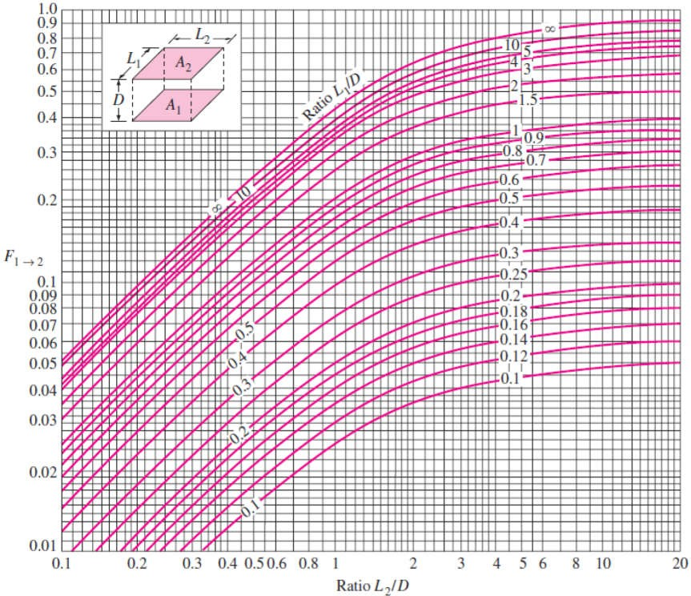
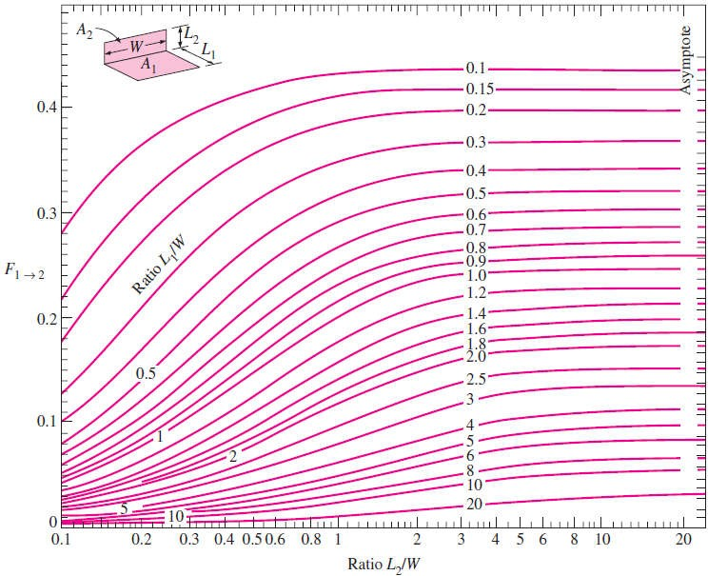
Chapter Eight
Radiation Heat Transfer
Fig.(8.8) View factor between two aligned parallel rectangles of
equal size
Fig.(8.9) View factor between two perpendicular rectangles with a common edge

Slide 5
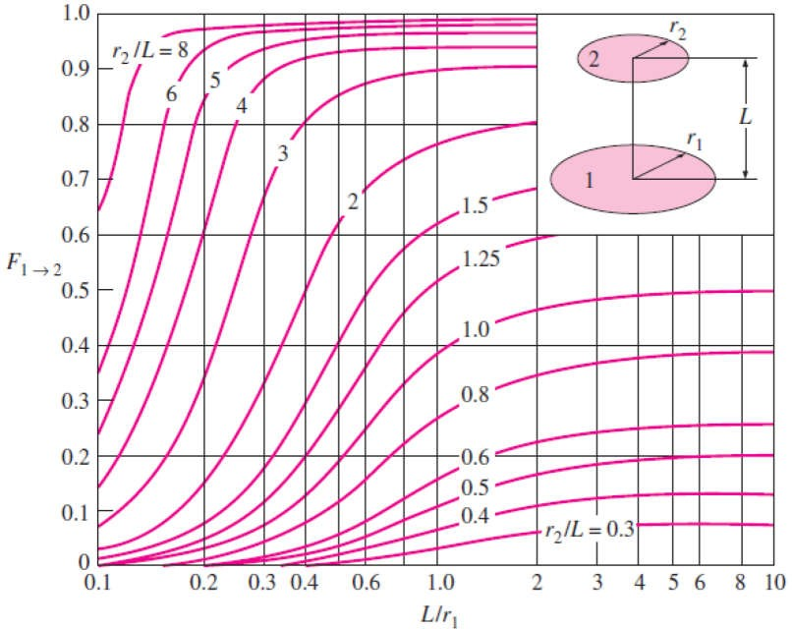
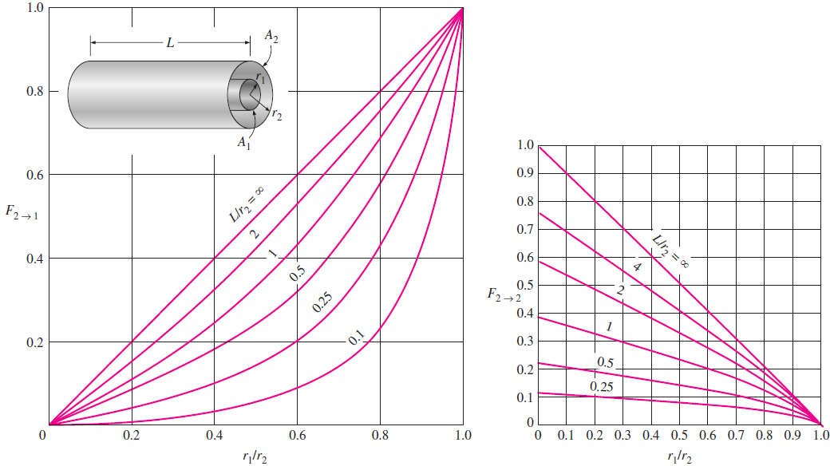
Chapter Eight
Radiation Heat Transfer
Fig.(8.10) View factor between two coaxial parallel disks
Fig.(8.11) View factors for two concentric cylinders of finite length;
(a) outer cylinder to inner cylinder; (b) outer cylinder to itself

Slide 6
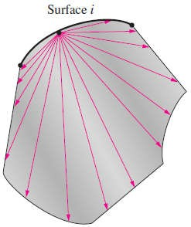


Chapter Eight
Radiation Heat Transfer
8.5- View Factor Relations
Radiation analysis on an enclosure consisting of N surfaces requires the evaluation of N ² view factors. However, it is neither practical nor necessary to evaluate all of the view factors directly. Once a sufficient number of view factors are available, the rest of them can be determined by using some fundamental relations for view factors, as discussed next.
8.5.1- The Reciprocity Relation
The view factors F and F are not equal to each other unless the areas of the two surfaces are equal. That is,
F i = F when Ai = Aj F i F when Ai j
where we have shown earlier the pair of view factors F and
F
i are related to each other by;
Ai F = Aj F
8.5.2- The Summation Rule
The conservation of energy principle requires that the entire radiation leaving any surface i of an enclosure be intercepted by the surfaces of that enclosure as shown in Fig.(8.12). Therefore, the sum of the view factors from surface i of an enclosure to all surfaces of the enclosure, including to itself, must equal unity. This is known as the summation rule for an enclosure and is
expressed as;
N
F_{i}
j
1 (8.7)
j 1
where N is the number of surfaces of the enclosure. For example, applying the summation rule to surface 1 of a three-surface enclosure yields;
3
F₁ 1 F₁
1
j 1
j 1 ^{F}1 2 ^{F}1 3
The summation rule can be applied to each surface of an
Fig.(8.12) Radiation leaving any surface i
of an enclosure must be intercepted
enclosure by varying i from 1 to N. Therefore, the summationcompletely by the surfaces of the enclosure.
rule applied to each of the N surfaces of an enclosure gives NTherefore, the sum of the view factors from
relations for the determination of the view factors. Also, the surface i to each one of the surfaces of the
reciprocity rule gives N(N - 1)/2 additional relations. Then the
enclosure must be unity
total number of view factors that need to be evaluated directly for an N-surface enclosure becomes;
N² - [N+ N(N - 1 )/2]= N(N - 1)/2
For example, for a six-surface enclosure, we need to determine only 6×(6 - 1)/2 = 15 of the 6 ² = 36 view factors directly. The remaining 21 view factors can be determined from the 21 equations that are obtained by applying the reciprocity and the summation rules.

Slide 7
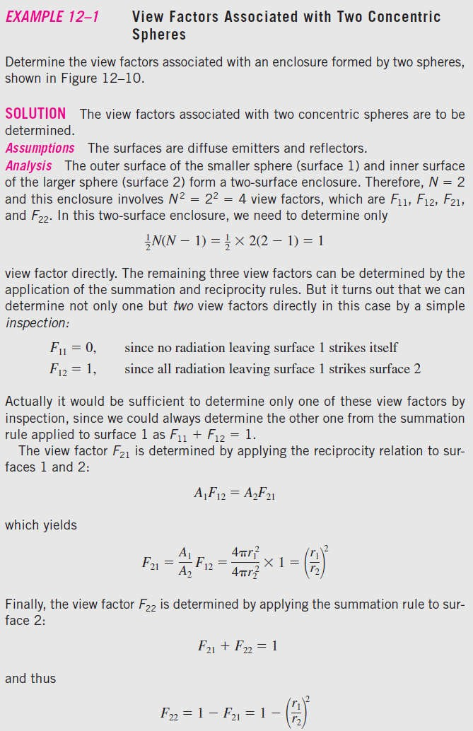
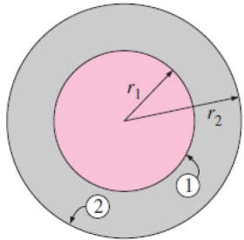
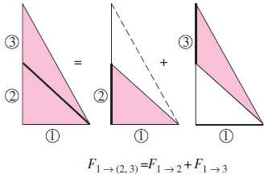
Chapter Eight
Radiation Heat Transfer
8.1-
Fig.(8.13) The geometry considered in Example- 8.1
8.5.3- The Superposition Rule
In some cases, it is desirable to express the given geometry as the sum or difference of some geometries with known view factors, and then to apply the superposition rule, which can be expressed as the view factor from a surface i to a surface j is equal to the sum of the view factors from surface i to the parts of surface j.
Note:- The reverse of this rule not true. That is, the view factor
from a surface j to a surface i is not equal to the sum of the view factors from the parts of surface j to surface i.
Consider the geometry in Fig.(8.14). The radiation that leaves surface 1 and strikes the combined surfaces 2 and 3 is equal to the sum of radiations that strike surfaces 2 and 3. Therefore, the view factor from surface 1 to the combined surfaces of 2 and 3 is;
F1 (2, 3) = F1 2 + F1 3
Fig.(8.14) The view factor from a surface to a composite surface is equal to the sum of the view factors from the surface to the parts of the composite surface

Slide 8
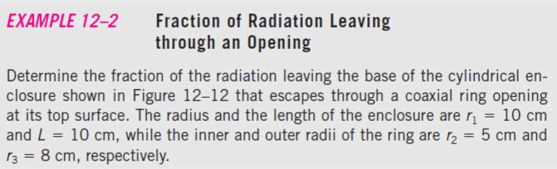
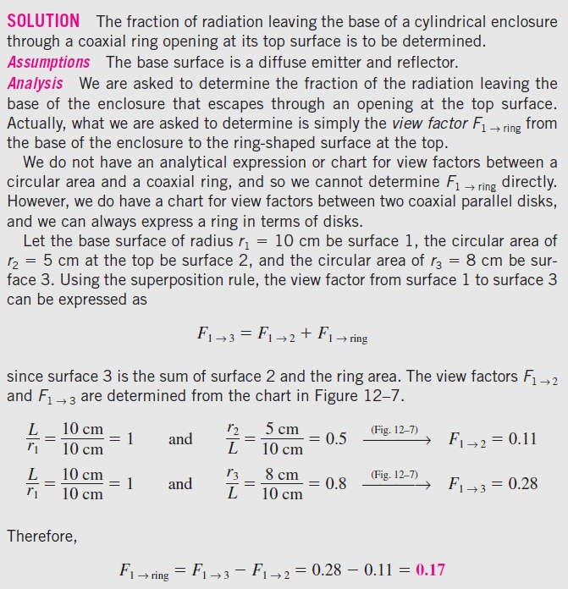
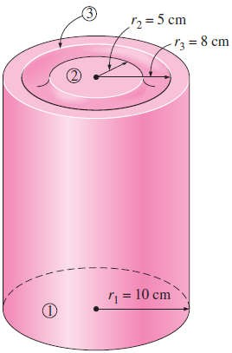
Chapter Eight Radiation Heat Transfer
Suppose we need to find the view factor F1 3. It is clear that the direct evaluation for such a view factor is un available. However, the view factor F1 3 can be determined from Eq.(8.8) after determining both F1 2 and F1 (2, 3) from the chart in Fig.(8.8). Therefore, it may be possible to determine some difficult view factors with relative ease by expressing one or both of the areas as the sum or differences of areas and then applying the superposition rule.
To obtain a relation for the view factor F(2, 3) 1, we multiply Eq.(8.8) by A1 as follow;
A1 F1 (2, 3) = A1 F1 2 + A1 F1 3
and apply the reciprocity relation to each term to get;
(A2 + A3) F(2, 3) 1 = A2 F2 1 + A3 F3 1
Or;
A₂ F₂ A₃ F₃
F
(2,3) 1
1 1
(8.9)
A A
2 3
Note:- Areas that are expressed as the sum of more than two parts can be handled in a similar manner.
8.2-
Fig.(8.15) The cylindrical enclosure considered in Example- 8.2
Fig.(8.10)
Fig.(8.10)

Slide 9
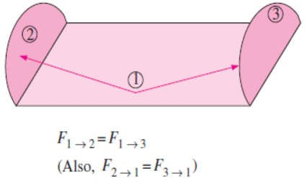
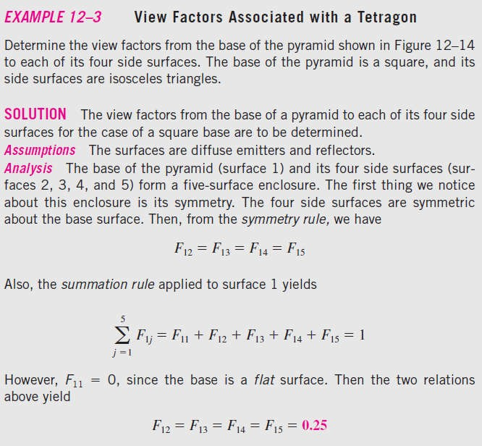
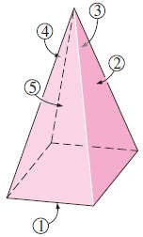
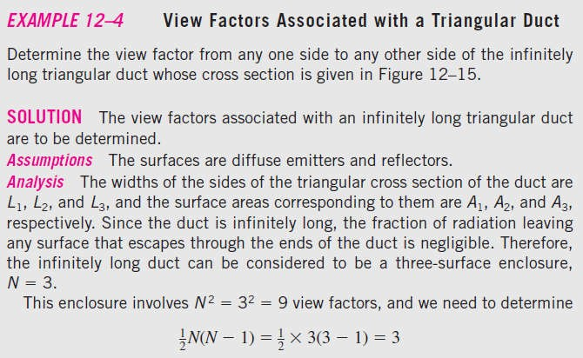
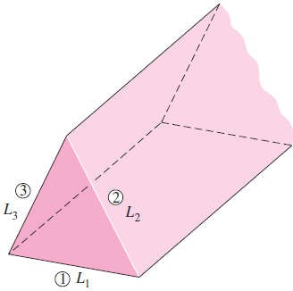
Chapter Eight
Radiation Heat Transfer
8.5.4- The Symmetry Rule
It is important to check for the presence of any symmetry in a problem before attempting to determine the view factors directly. The presence of symmetry can be determined by inspection. The symmetry rule can be expressed as two (or more) surfaces that possess symmetry about a third surface will have identical view factors from that surface Fig.(8.16). Note:- The symmetry rule can also be expressed as if the surfaces j and k are symmetric about the surface i then F
= F . Using the reciprocity rule, we can show that the relation F = F is also true in this case.
Fig.(8.16) Two surfaces that are symmetric about a third surface will have the same
view factor from the third surface
8.3-
Fig.(8.17) The pyramid considered in Example-8.3
8.4-
Fig.(8.18) The infinitely long triangular duct considered in Example-8.4

Slide 10
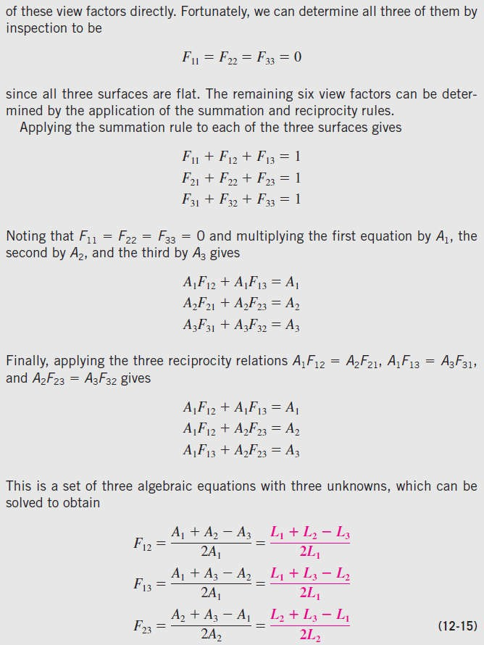
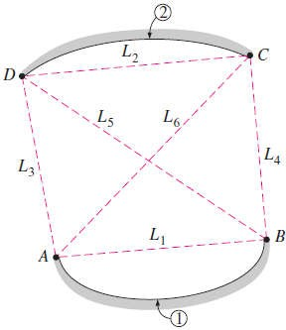


Chapter Eight
Radiation Heat Transfer
8.5.5- View Factors between Infinitely Long Surfaces: The Crossed-Strings Method
The geometries such as channels and ducts that are very long can
be modeled as being infinitely long, and the view factor between their surfaces is determined by the crossed-strings method, as
shown in Fig.(8.19). So, to find the view factor F1 between
surfaces 1 and 2, we first identify the endpoints of the surfaces (the points A, B, C, and D) and connect them to each other with tightly stretched strings. After that, the view factor F will be as follow;
F
(L₅ L₆ ) (L₃ L₄ )
2 L
...(8.11)
F
1 2
1
Note1:- The expression (L5 + L6) represents the sum of lengths of the crossed strings, while (L3 + L4) represents the sum of the lengths of the uncrossed strings attached to the endpoints. Therefore, the crossed-strings method can be expressed verbally as follow;
(Crossed strings)-
(Uncrossed strings)
(8.12)
Fig.(8.19) Determination of the view factor F by the application of the crossed-strings method
i j
2 (String on surface i)

Slide 11
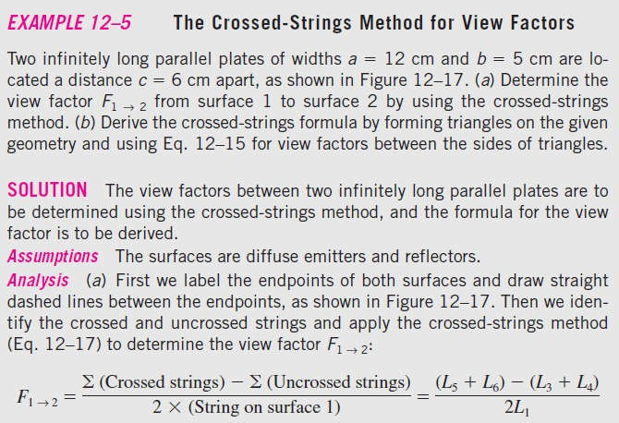
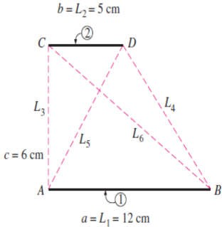
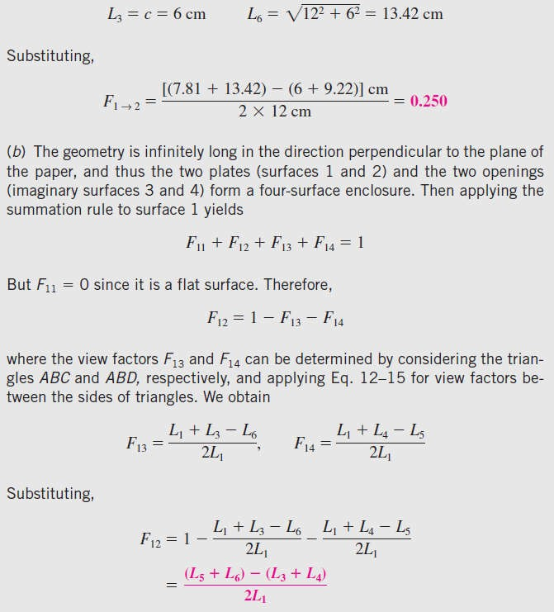
Chapter Eight Radiation Heat Transfer
Note2:- The crossed-strings method is applicable even when the two surfaces considered share a common edge, as in a triangle. In such cases, the common edge can be treated as an imaginary string of zero length. The method can also be applied to surfaces that are partially blocked by other surfaces by allowing the strings to bend around the blocking surfaces.
8.5-
Fig.(8.20) The two infinitely long parallel plates considered in Example-8.5
By Assistant Lecturer Ahmed N. Al- Mussawy

Slide 12
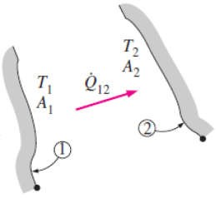


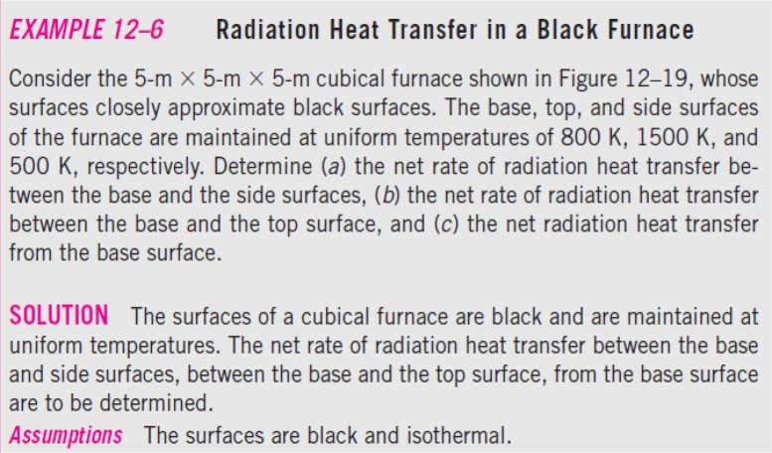
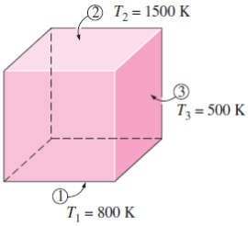
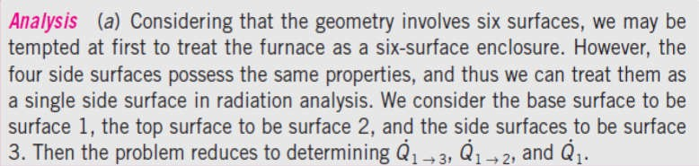
Chapter Eight
Radiation Heat Transfer
6

Slide 13
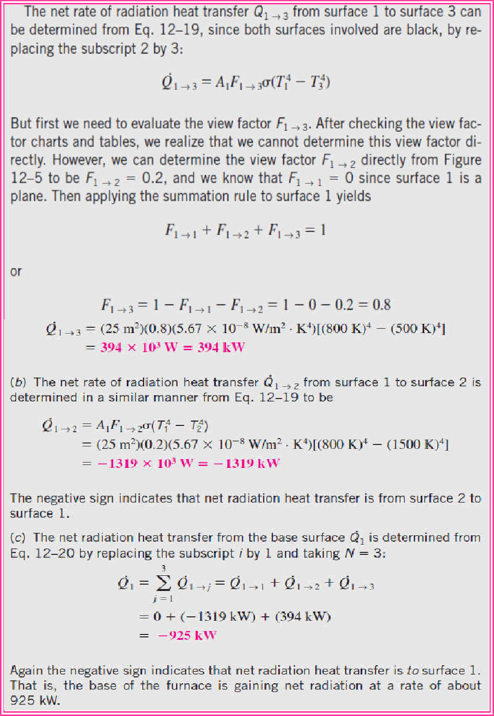
Chapter Eight
Radiation Heat Transfer
8.7- Radiation Heat Transfer: Diffuse, Gray Surfaces
Most enclosures encountered in practice involve non-black surfaces, which allow multiple reflections to occur. To make a simple radiation analysis possible, it is common to assume the surfaces of an enclosure to be opaque, diffuse, and gray. That is, the surfaces are nontransparent, they are diffuse emitters and diffuse reflectors. Also, each surface of the enclosure is isothermal, and both the incoming and outgoing radiation are uniform over each surface.
8.7.1- Radiosity
Surfaces emit radiation as well as reflect it, and thus the radiation leaving a surface consists of emitted and reflected parts. The calculation of radiation heat transfer between surfaces involves the total radiation energy streaming away from a surface, with no regard for its origin. The total radiation energy leaving a surface per unit time and per unit area is the radiosity and is denoted by J as shown in Fig. (8.23).
For a surface i that is gray and opaque ( i i and i + i =1), the radiosity can be expressed as;

Slide 14
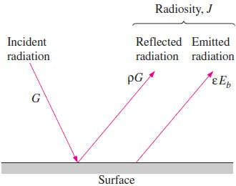
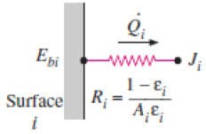
Chapter Eight
Radiation Heat Transfer
J
Radiation emitted by surface i
Radiation reflected by surface i
i
i ^{E}bi i ^{E}bi
i ^{G}i
(1 _{i} )G_{i} (W) (8.16)
where Ebi i ⁴ is the blackbody emissive power of surface i and Gi is irradiation (i.e., the radiation energy incident on surface i per unit time per unit area). For a surface that can be approximated as a
blackbody i = 1, the radiosity relation reduces to;
Ji = Ebi
_{T} 4
(blackbody)
i
Fig.(8.23) Radiosity represents the sum of the radiation energy emitted and reflected by a surface
8.7.2- Net Radiation Heat Transfer to or from a Surface
The net rate of radiation heat transfer from a surface i of surface area Ai is
denoted by Qi and is expressed as;
Radiation leaving
Radiation incident on entire surface i
(8.18)
Q
entire surface i A_{i} (J _{i} - G_{i} ) (W)
i
By solving for Gi from Eq.(8.16) and substituting into Eq.(8.18) yields;
Q A J
₋ J _{i}
i ^{E}bi
i
A_{i} 1
i
E_{bi} J _{i} (W) (8.18)
Fig.(8.24) Electrical analogy of surface resistance to radiation
i
i i
1
i
Some Useful Notes 1-
Q
^{E}bi
J _{i}
(W)
(8.19.a )
i
R
i
Where the surface resistance to radiation is;
R
1
A
i
(8.19.b)
i
i i
The quantity (Ebi - Ji) corresponds to a potential difference and the net rate of radiation heat transfer corresponds to current in the electrical analogy, as illustrated in Fig.(8.24).
2-
The direction of the net radiation heat transfer depends on the relative magnitudes of Ji (the
radiosity) and Ebi (the emissive power of a blackbody at the temperature of the surface). It will be
from the surface if Ebi > Ji and to the surface if Ji > Ebi .
3- All of the radiation energy gained must be removed from the other side of the surface through some mechanism if the surface temperature is to remain constant.
4-
The surface resistance to radiation for a blackbody is zero since i = 1 and Ji = Ebi .
5-
Some surfaces encountered in numerous practical heat transfer applications are modeled as being
adiabatic since their back sides are well insulated and the net heat transfer through them is zero. So, the surface must lose as much radiation energy as it gains, and thus Qi =0. In such cases, the surface is said to reradiate all the radiation energy it receives, and such a surface is called a reradiating surface. Setting Qi =0 in Eq.(8.19.a) yields Ji = Ebi Ti⁴.

Slide 15
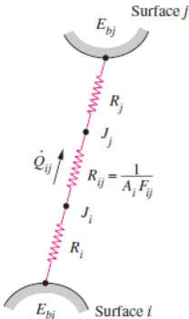
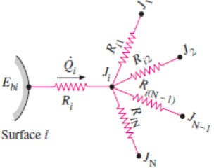




Chapter Eight Radiation Heat Transfer
8.7.3- Net Radiation Heat Transfer between Any Two Surfaces
Consider two diffuse, gray, and opaque surfaces of arbitrary shape maintained at uniform temperatures, as shown in Fig.(8.25). Recognizing that the radiosity J represents the rate of radiation leaving a surface per unit surface area and that the
view factor Fi represents the fraction of radiation leaving surface i that strikes surface j, the net rate of radiation heat transfer from surface i to surface j can be expressed as;
Radiation leaving the entire surface i that strikes surface j
Radiation leaving the entire surface j that strikes surface i
Q_{i}
j
A_{i} J _{i} F_{i j} - A_{j} J _{j} F_{j}
i
(W) (8.20)
= Aj F yields;
Applying the reciprocity relation Ai F
Fig.(8.25) Electrical analogy of space resistance to radiation
Q = Ai F (Ji Jj ) (W)
I
e previous equation can be rearranged as;
(W) (8.22.a )
^{Q}i j
J _{i} J _{j}
R _{j}
i
Where the space resistance to radiation is;
1
R (8.22.b)
i j
A F
i i j
Again the quantity (Ji - Jj) corresponds to a potential difference, and
Fig.(8.26) Network representation of net radiation heat transfer from surface i to the remaining surfaces of an N-surface enclosure
the net rate of heat transfer between two surfaces corresponds to
current in the electrical analogy, as illustrated in Fig.(8.25).
Note- In an N-surface enclosure as shown in Fig.(8.26), the conservation of energy principle requires that the net heat transfer from surface i be equal to the sum of the net heat transfers from surface i to each of the N surfaces of the enclosure. That is;
Q
N N
Q A F (J J )
^{N} (J _{i} J _{j} )
j
(W) (8.23.a )
i i j i i j i j
R
j 1 j 1 j 1 i
The network representation of net radiation heat transfer from surface i to the remaining surfaces of an
N-surface enclosure is given in Fig.(8.25). Combining Eqs.[(8.19.a) & (8.23.a)] gives;
J _{i} (J _{i} J _{j} )
^{E}bi
N
(W) (8.23.b)
^{R}i j 1 ^{R}i j
which has the electrical analogy interpretation that the net radiation flow from a surface through its surface resistance is equal to the sum of the radiation flows from that surface to all other surfaces through the corresponding space resistances.
8.8- Network Method of Solving Radiation Problems
The network method is based on the electrical network analogy, where that method was found
widespread acceptance because of its simplicity and emphasis on the physics of the problem. The application of the method is straightforward:
Draw a surface resistance associated with each surface of an enclosure and connect them with space resistances.
Then solve the radiation problem by treating it as an electrical network problem where the radiation heat transfer replaces the current and radiosity replaces the potential.
Next we apply the method to solve radiation problems in two- and three-surfaces enclosures, where this method is not practical for enclosures with more than three or four surfaces, however,
because of the increased complexity of the network.

Slide 16
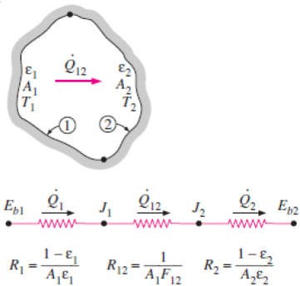

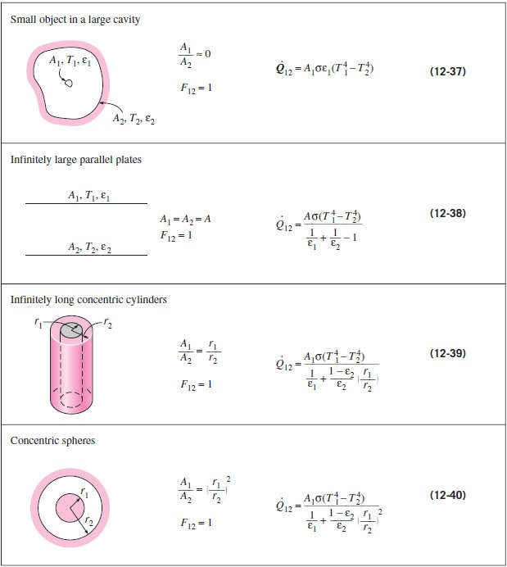
Chapter Eight
Radiation Heat Transfer
8.8.1- Radiation Heat Transfer in Two-Surface Enclosures
Consider an enclosure consisting of two opaque surfaces as shown in Fig.(8.27), and try to determine the net rate of radiation heat transfer between the two surfaces with the network method.
Surfaces 1 & 2 have emissivities 1 & 2 and surface areas A1 & A2
and are maintained at uniform temperatures T1 & T2, respectively.
The radiation network of this two-surface enclosure consists of two surface resistances and one space resistance as shown in Fig.(8.27). The net rate of radiation transfer will be expressed as;
^{E}b1 ^{E}b 2
Q Q
Q (W) (8.24.a)
12 1
2
R R R
Or;
1
12
2
Fig.(8.27) Schematic of a two-surface enclosure and the radiation network associated with it
4 4
^{Q}12
(T T )
(W)
(8.24.b)
1
A₁
1 2
1
A₂
1
1 ^{A}1 ^{F}12
1
2
2
Note- This important result is applicable to any two gray, diffuse, opaque surfaces that form an
enclosure. The view factor F12 depends on the geometry and must be determined first. Simplified forms of Eq.(8.24.b) for some familiar arrangements that form a two-surface enclosure are given in Table(8.1). Note that F12 = 1 for all of these special cases.
Table (8.1)

Slide 17
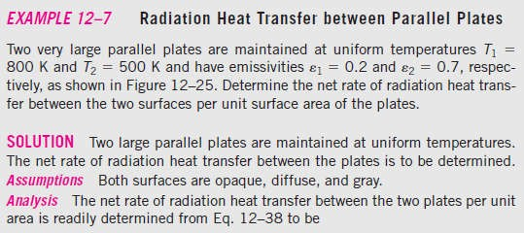
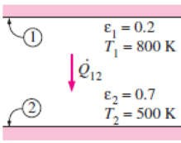
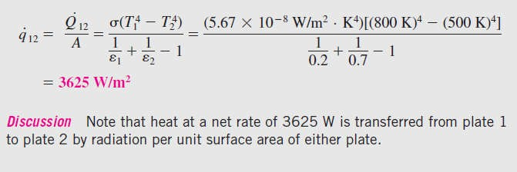

Chapter Eight
Radiation Heat Transfer
8.7-
Fig.(8.28) The two parallel plates considered in Example- 8.7
8.8.2- Radiation Heat Transfer in Three-Surface Enclosures
We now consider an enclosure consisting of three opaque, diffuse, gray surfaces, as shown in
Fig.(8.29). Surfaces 1, 2, and 3 have surface areas A1, A2, and A3; emissivities 1, 2, and 3; and uniform temperatures T1, T2, and T3, respectively. The radiation network of this geometry is constructed by following the standard procedure: draw a surface resistance associated with each of the three surfaces and connect these surface resistances with space resistances, as shown in the figure. Relations for the surface and space resistances are given by Eqs. [(8.19.b) and (8.22.b)]. The three endpoint potentials Eb1, Eb2 and Eb3 are considered known, since the surface temperatures are specified. Then all we need to find are the radiosities J1, J2, and J3. The three equations for the determination of these three unknowns are obtained from the requirement that the algebraic sum of the currents (net radiation heat transfer) at each node must equal zero. That is;
For node J
^{E}b1
R
J₁
J ₂ J₁ J ₃ J₁
12 13
0
1
1
R
R
For node J
J₁ J ₂
12
^{E}b 2
R
J ₂
J ₃ J ₂
0
(8.25)
2
R
R
^{E}b 3
2
23
J₁ J ₃
13 23 3
J ₃
For node J
J ₂ J ₃
0
3
R R R
Once the radiosities J1, J2 , and J3 are available, the net rate of radiation heat transfers at each surface can be determined from Eq.(8.23.a). The set of equations above simplify further if one or more
Ji = Ebi = i⁴ for a black or reradiating surface. Also, Qi= 0 for a reradiating surface. Finally, when the net rate of radiation heat transfer Qi is specified at surface i instead of the temperature, the term (Ebi - Ji)/Ri should be replaced by the specified Qi.

Slide 18
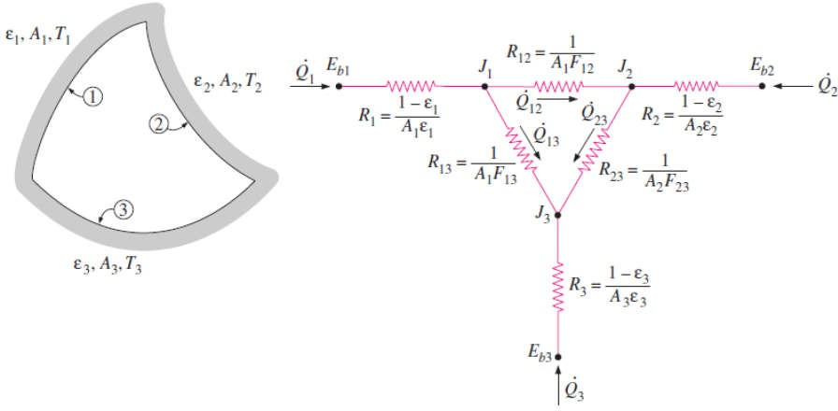
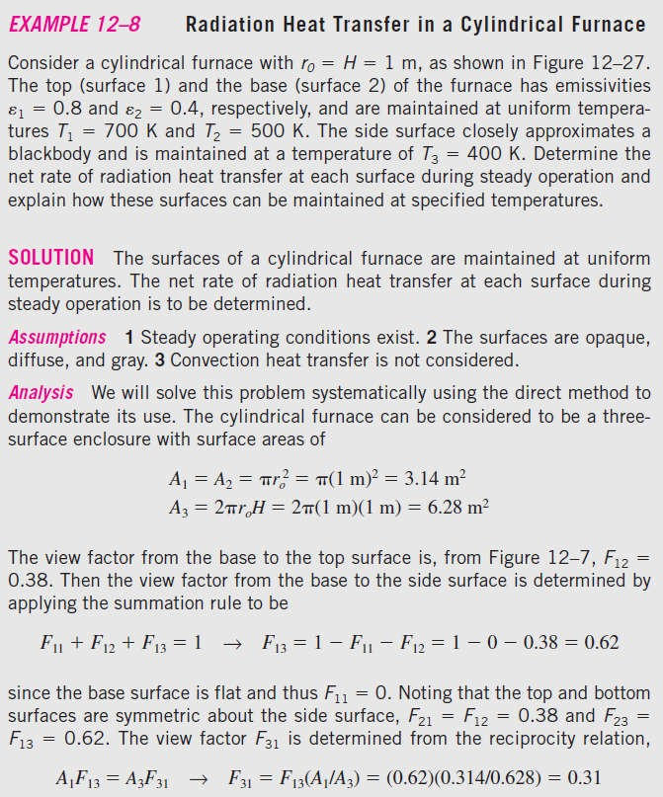
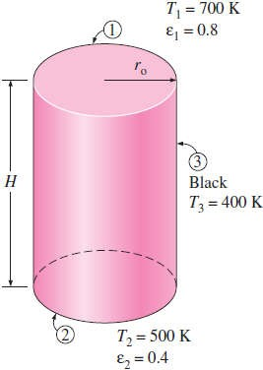
Chapter Eight
Radiation Heat Transfer
Fig.(8.29) Schematic of a three-surface enclosure and the radiation network associated with it
8.8-
Fig.(8.30) The cylindrical furnace considered in Example- 8.8

Slide 19
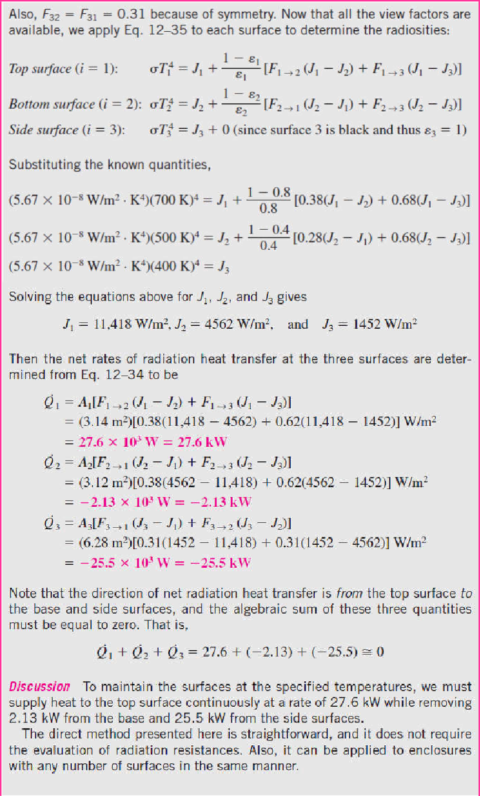
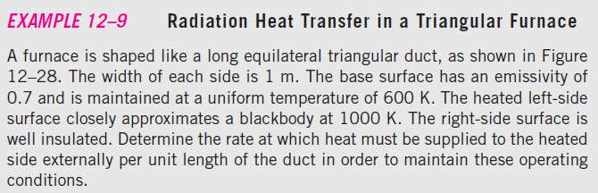
Chapter Eight
Radiation Heat Transfer
8.9-

Slide 20
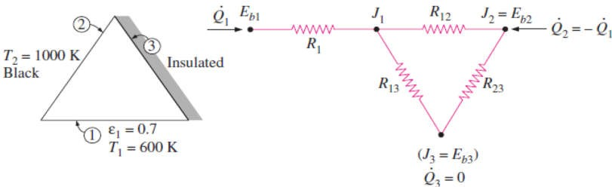
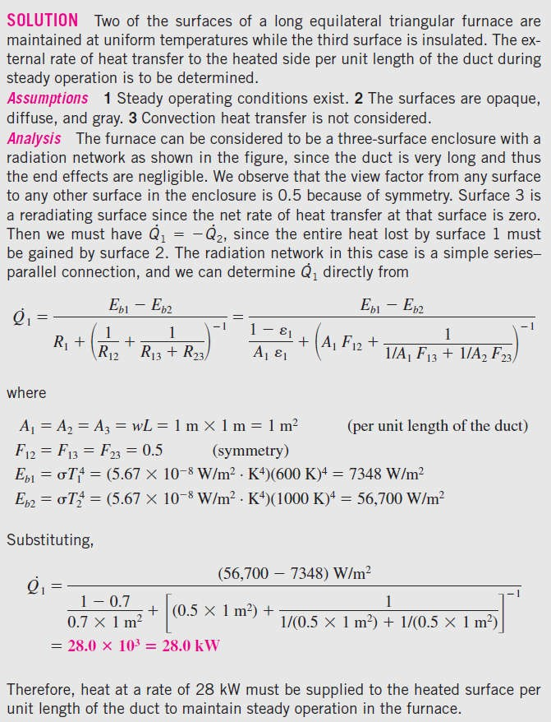


Chapter Eight
Radiation Heat Transfer
Fig.(8.31) The triangular furnace considered in Example- 8.9
8.10-
Fig.(8.32) Schematic for Example- 8.10

Slide 21

Chapter Eight
Radiation Heat Transfer
By Assistant Lecturer Ahmed N. Al- Mussawy

Slide 22

Chapter Eight
Radiation Heat Transfer

Slide 23

Chapter Eight
Radiation Heat Transfer

Slide 24






Chapter Eight
Radiation Heat Transfer
PROBLEMS
8.1- Determine the view factors F13 and F23 between the rectangular surfaces shown in below figure.
Answers: 0.24, 0.05
8.6- Determine the view factors from the base of a cube to each of the other five surfaces.
Answer: 0.2 8.7- Consider a conical enclosure of height h and base diameter D. Determine the view factor from
the conical side surface to a hole of diameter d
located at the center of the base.
Answer: d²/(2Dh)
Prob.(8.1)
8.2- Consider a cylindrical enclosure whose height is twice the diameter of its base. Determine the view factor from the side surface of this cylindrical enclosure to itself.
Answer: 0.38
Prob.(8.7)
8.8- Determine the four view factors associated with an enclosure formed by two very long concentric cylinders of diameters D1 and D2. Neglect the end effects.
8.3- Consider a hemispherical furnace with a flat circular base of diameter D. Determine the view factor from the dome of this furnace to its base.
Answer: 0.5 8.4- Determine the view factors F12 and F21 for the very long ducts shown in below figure without using any view factor charts. Neglect end effects. Answers: (a) 1, 0.64, (b) 0.5, a /2b
Answers: 0, 1, D1 /D2 , 1- (D1 /D2 )
8.9- Determine the view factor F12 between the rectangular surfaces shown in below figure.
Answers: (a) 0.07, (b) 0.07, (c) 0.08
Prob.(8.4)
Prob.(8.4)
8.5- Determine the view factors from the very long grooves shown in below figure to the surroundings without using any view factor charts. Neglect end effects.
Answers: (a) 0.64, (b) a /2b, (c) a /(a+2b)
Prob.(8.9)
8.10- Two infinitely long parallel cylinders of diameter D are located a distance s apart from each other. Determine the view factor F12 between these two cylinders.
8.11- Three infinitely long parallel cylinders of diameter D are located a distance s apart from each other. Determine the view factor between the cylinder in the middle and the surroundings.
Prob.(8.5)
By Assistant Lecturer Ahmed N. Al- Mussawy

Slide 25



Chapter Eight
Radiation Heat Transfer
8.16- Two parallel disks of diameter D = 0.6m separated by L = 0.4m are located directly on top of each other. Both disks are black and are maintained at a temperature of 700K. The back sides of the disks are insulated, and the environment that the disks are in can be considered to be a blackbody at T =300K. Determine the net rate of radiation heat transfer from the disks to the environment.
Answer: 5505 W
8.17- A furnace is shaped like a long equilateral- triangular duct where the width of each side is 2m. Heat is supplied from the base surface,
Prob.(8.11)
8.12- Two very large parallel plates are maintained at uniform temperatures of T1 = 600K and T2 = 400K and have emissivities 1 = 0.5 and
2 = 0.9, respectively. Determine the net rate of radiation heat transfer between the two surfaces per unit area of the plates. Answer: 2795 W/m²
whose emissivity is 1 = 0.8, at a rate of 800
8.13- A furnace is of cylindrical shape with R = H = 2m. The base, top, and side surfaces of the furnace are all black and are maintained at uniform temperatures of 500, 700, and 1200K, respectively. Determine the net rate of radiation heat transfer to or from the top surface during steady operation. Answer: -762 W
W/m² while the side surfaces, whose emissivities are 0.5, are maintained at 500K. Neglecting the end effects, determine the temperature of the base surface. Can you treat this geometry as a two-
surface enclosure? Answer: 543K
8.18- Consider a 4m×4m×4m cubical furnace whose floor and ceiling are black and whose side surfaces are reradiating. The floor and the ceiling of the furnace are maintained at temperatures of 550K and 1100K, respectively. Determine the net rate of radiation heat transfer between the floor and the ceiling of the furnace. Answer: 747 W
8.19- Two concentric spheres of diameters D1 = 0.3m and D2 = 0.8m are maintained at uniform temperatures T1 = 700K and T2 = 400K and have
Prob.(8.13)
8.14- Two very long concentric cylinders of diameters D1= 0.2m and D2=0.5m are maintained at uniform temperatures of T1 = 950K and T2 =
emissivities 1 = 0.5 and 2 = 0.7, respectively.
500K and have emissivities 1 = 1 and 2 = 0.7,
Determine the net rate of radiation heat transfer between the two spheres. Also, determine the
respectively. Determine the net rate of radiation
convection heat transfer coefficient at the outer surface if both the surrounding medium and the surrounding surfaces are at 30C°. Assume the emissivity of the outer surface is 0.35.
Answers: 1669 W, 5.04 W/m²·C°
8.20- A spherical tank of diameter D = 2m that is filled with liquid nitrogen at 100K is kept in an evacuated cubic enclosure whose sides are 3m long. The emissivities of the spherical tank and
heat transfer between the two cylinders per unit
length of the cylinders. Answer: 22.87 kW
8.15- A long cylindrical rod of diameter D1 = 0.01m is coated with this new material and is placed in an evacuated long cylindrical enclosure of diameter D2 = 0.1m and emissivity 2 = 0.95, which is cooled externally and maintained at a temperature of 200K at all times. The rod is heated by passing electric current through it. When steady operating conditions are reached, it is observed that the rod is dissipating electric power at a rate of 8W per unit of its length and its surface temperature is 500K. Based on these measurements, determine the emissivity of the coating on the rod. Answer: 0.074
the enclosure are = 0.1 and = 0.8,
1 2
respectively. If the temperature of the cubic
enclosure is measured to be 240K, determine the net rate of radiation heat transfer to the liquid nitrogen. Answer: 228 W
Prob.(8.20)

Slide 26

Chapter Eight
Radiation Heat Transfer
8.21- Consider two rectangular surfaces perpendicular to each other with a common edge which is 1.6m long. The horizontal surface is 0.8m wide and the vertical surface is 1.2m high. The horizontal surface has an emissivity of 0.75 and is maintained at 400K. The vertical surface is black and is maintained at 550K. The backsides of the surfaces are insulated. The surrounding surfaces are at 290K, and can be considered to have an emissivity of 0.85. Determine the net rate of radiation heat transfers between the two surfaces, and between the horizontal surface and the surroundings. Answer: 1245 W, 725 W
Prob.(8.21)

